Slide 1
Travel support case study #1 – research data stolen
An academic was travelling to China and didn’t complete a risk assessment because she knew the country well
She took her real laptop and phone with all her research data
While she was there, her phone and laptop were hacked and her data stolen
If she had completed a risk assessment, it would have prompted her to think about the risk to IP and to consider precautions – eg taking a dummy laptop, encrypting data
Risk assessments can help to protect against loss of valuable IP and research data

Slide 2
Travel support case study #2 – £2000 unexpected transport costs
A student didn’t complete a risk assessment for a conference in California
She had assumed that she would be able to walk between her hotel and the conference venue and hadn't budgeted for travel costs. In fact, though the distance was short, there was no safe pedestrian route and she had to take taxis
Worried that her funding wouldn't cover so many taxi fares, she tried to hire a car instead and paid a deposit, but this cleared her out of funds and she became very anxious, both about money and safety
Her department reimbursed the car deposit and paid for taxis for the duration of the conference – about £2000 in total
A risk assessment would have prompted her to think about transport in more detail. Either more funding could have been awarded to cover the taxi fares (saving her distress while on her trip) or another hotel might have been found with better transport links to the conference venue.
A risk assessment can help you budget realistically and make safer and more accurate travel plans, even for superficially familiar (Western, urban) destinations.

Slide 3
Travel support case study #3 – a medical bill of £200,000
An academic became ill while at a conference in the USA
He sought treatment without contacting the University insurer – who would normally advise on choice of hospital, tests, treatment plan etc
During an extended hospital stay covering recuperation as well as initial urgent treatment, he ran up a bill of over £200,000
The insurers refused to pay because the proper procedure had not been followed, and the bill ultimately came back to the individual’s department
If he had done the appropriate pre-travel preparation, he would have been reminded of the correct procedures for medical emergencies and been prompted to keep copies of the relevant contact numbers
Not following the procedures for travel safety can cost the University substantial sums of money, taking budget away from core research and teaching

Slide 4
Travel support case study #4 – medical emergency fully covered
An academic with an underlying health condition was travelling to the USA
He completed a risk assessment (including contingency planning for medical emergencies), declared his health condition to the University insurers who arranged additional cover, and booked flights and accommodation through Key Travel
On his second day in the US he had a heart attack and was admitted to hospital
Because he was fully insured, taking account of his underlying medical condition, all his medical bills were resolved without any involvement from him
Key Travel were able to amend bookings, saving stress for him and his wife who was travelling with him, and the insurers paid for the costs of his wife's extended stay
The University's travel safety provisions give you excellent support in a medical emergency, taking care of practicalities so you can concentrate on getting better.

Slide 5
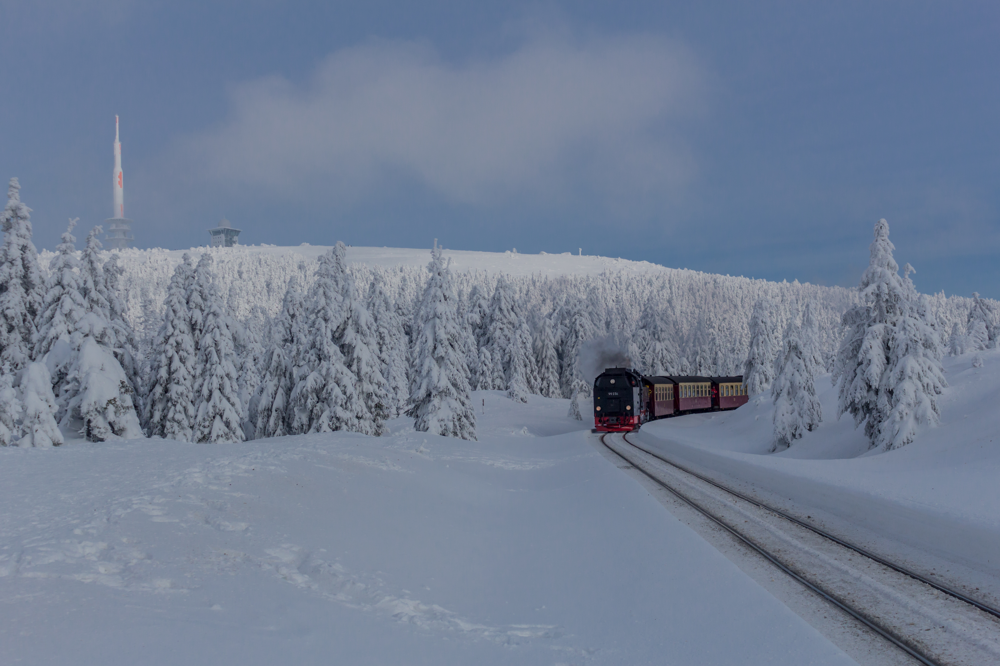
Travel support case study #5 – getting students out of Russia
When Russia’s war against Ukraine started, there were a number of MML students in Russia, doing their year abroad
All flights were cancelled so the students were stranded in a hostile country
The University paid for its emergency response service to help the students get out by train, bus and other routes
Because the department held excellent, up-to-date contact details for all students, they were all safely extracted from Russia within 72 hours
Having accurate and easily accessible contact details means we can act quickly and effectively in an urgent situation to keep our people safe

Slide 6
Travel support case study #6 – sudden conflict in the Middle East
When hostilities broke out in Israel and Gaza in October 2023, the University did not know how many academics were in the region and might be in danger
It took three days to find and contact all the University members in affected countries
If they had all used Peregrine Foresight to record their travel, the University would have had instant access to their destination and contact details and could have got help faster to those who needed it
Without accurate and easily accessible contact details, it is harder to get help to people in an emergency

